Slide 1

Github

Slide 2

“Experience with version control is fast becoming a requirement for all data scientists”
–Rebecca Vickery

Slide 3

WHAT IS GITHUB?
Git is a Version Control Software
•
•
Github stores the files for your project in a remote location and checks the differences as you change your code
•
This allows you to roll back to previous versions of your project if you need to go back
•
Makes sharing and collaboration much easier using the Github website
Shiny from

Slide 4




OTHER VERSION CONTROL
There are other kinds of version control software, GitLab also uses git.
We will be using Github in this course, but if in a future life, you might use these others.
Shiny from

Slide 5
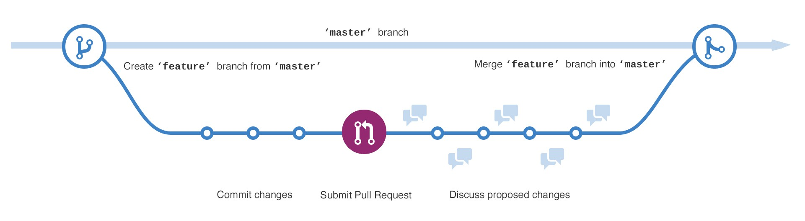

Slide 6
Github Desktop and the Web

Slide 7


EXERCISE
Download Github Desktop: https://desktop.github.com/ Sign up for Github: https://github.com/join
Got to course page: https://github.com/geoffreylarnold/welcome-to-the-tidyverse
‣
‣
‣
Clone this course repo
Create your own branch using your name, T# etc…

Slide 8
Github and Projects in RStudio

Slide 9
“R Projects are great.”
–Geoffrey Arnold

Slide 10
R PROJECTS
So what is all this?
Avoid messy environment
Keep custom functions in check
Don’t lose your work just because you want to do something else
Info: https://support.rstudio.com/hc/en-us/articles/200526207-Using-Projects
Shiny from

Slide 11
HOW DO PROJECTS WORK?
R typically saves your environment information in a default location (typically your Documents folder)
When you create a project it gets its own .RData file for the project in the Directory/folder you created
This is also the default working directory for your project, so no need to put all of the folders its in
Simply load objects by name if they’re in the project folder
Shiny from

Slide 12
EXERCISE
Create a “New Project”
Select “New Directory”
Select "New Project”
‣
Make sure the “Create a git repository” is selected
Give the project any name you want
Click “Create Project”
Look at the “Git” tab

Slide 13
EXERCISE
Click “File”
Click “New File”
Select “Shiny Web App”
‣
Give the application a name and click “Create” Click the “Git” tab
What’s change?
‣

Slide 14
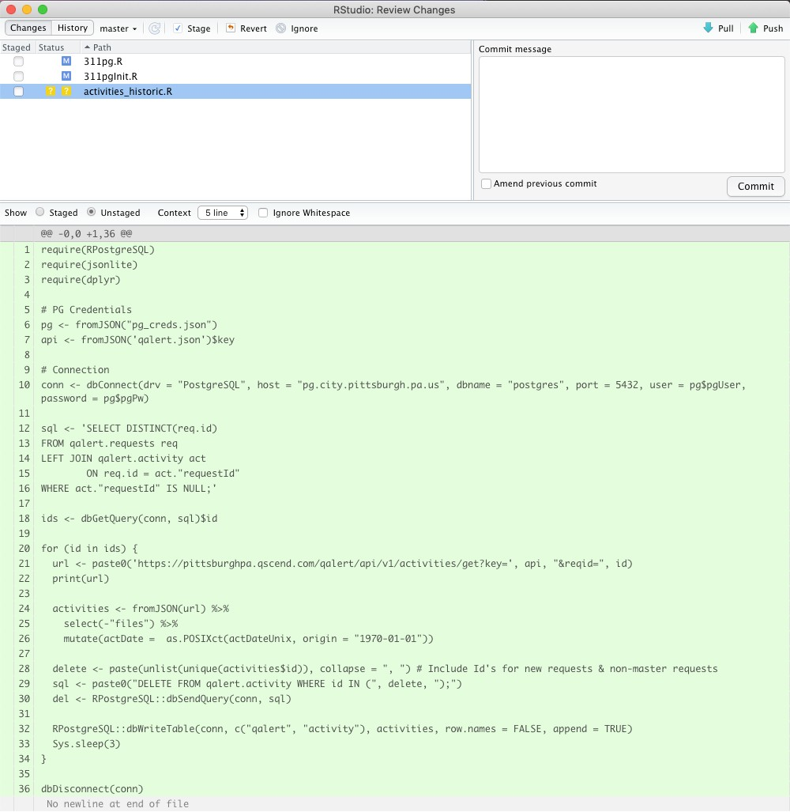
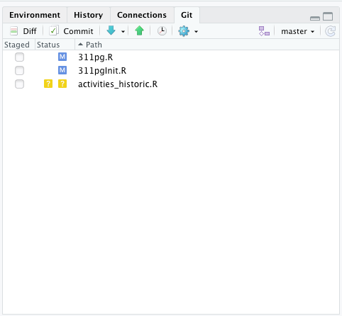
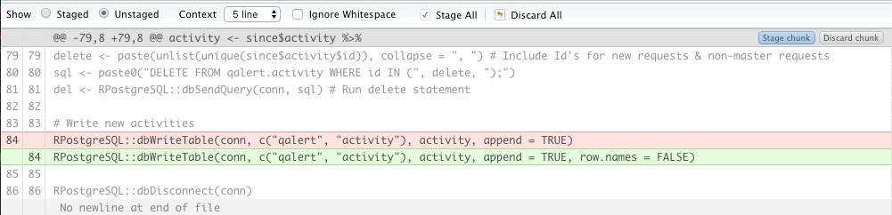

Slide 15
EXERCISE
Go to “Global Options”
Click “Git/SVN”
‣
Ensure “Enable version control interface for Studio projects” is selected
Click “Create RSA Key…”
Click “Create”
Click “View public key” and copy key
Go to https://github.com/settings/keys
Click “New SSH key”
Paste key in text box and give your key a name
Click “Add SSH Key”
‣
If you have two factor authorization turned on for GitHub (people with previous GitHub accounts may have this turned on) you will need your Personal Access Token to login later
‣
Everyone else, your GitHub login and password will be important when logging in later.

Slide 16
EXERCISE
Click the “Git” tab
Click “Commit”
‣
Type a message into the “Commit message” box
Stage the files by making sure they are selected on the left
Click “Commit”
Click “Push”
Login to GitHub with either your password or personal access token

Slide 17
Github in the command line / terminal

Slide 18
WHATS THE COMMAND LINE
Command or terminal git commands are how git was first used.
You don’t need to know how to do these things as either the “Git” tab in RStudio or the Github desktop program provides a GUI (gooey user interface) for you.
However, knowing the hard way to do something never hurt anybody.
Shiny from

Slide 19

EXERCISE
https://learngitbranching.js.org/
Complete Introduction Sequences
Git Commits
Branching Git
Merging in Git

